Slide 1
Chapter 5
Health and Wellness
Notes:
What do you do to stay healthy?

Slide 2

Conceptualizing Health Across the Life Span (1)
Biopsychosocial model of health:
  Incorporates biological and psychological factors with social and cultural factors

Slide 3
Conceptualizing Health Across the Life Span (2)
Health depends on characteristics of individuals interacting with characteristics of their family life and the broader cultural context.
Life span forces
  How do health outcomes change based on age?

Slide 4
Health and Wellness – Infancy (1 of 3)
Most common causes of infant mortality:
  Congenital malformations
  Low birth weight
  Maternal complications
Congenital malformations:
  Defects that are present at birth
  Leading cause of death during the first year

Slide 5

Health and Wellness – Infancy (2 of 3)
Changes in Sleep
  Infants Sleep on average12-15 hours/day
Infant Sleep cycles
  Newborns: 4-hour cycle; 3 hours sleep and 1 hour awake
  By 3-4 months: sleep for 5 to 6 hours straight
  By 6 months: sleep 10 to 12 hours at night

Slide 6
Health and Wellness – Infancy (3 of 3)
Sudden Infant Death Syndrome (SIDS): Sudden unexpected death of an infant less than 1 year of age that occurs seemingly during sleep and remains unexplained after a thorough investigation
In the US: 33/100,000 births (.033%) as of 2019
Risk factors
  Premature birth and low birth weight
  Parental smoking
  Child overheating and sleeping on stomach (considered the greatest risk factor)

Slide 7
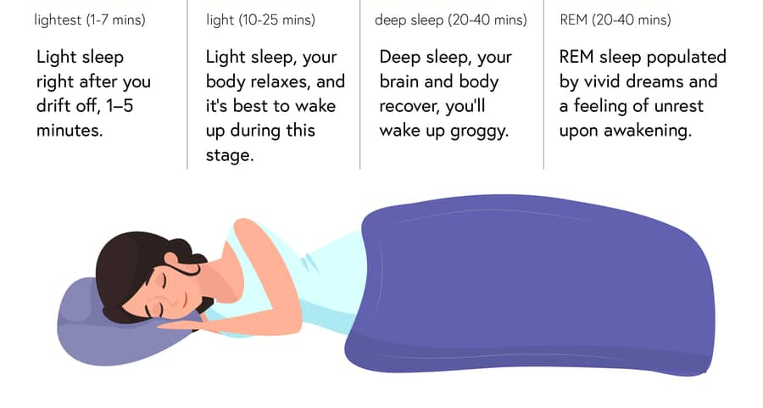
N1
N2
N3
REM

Slide 8
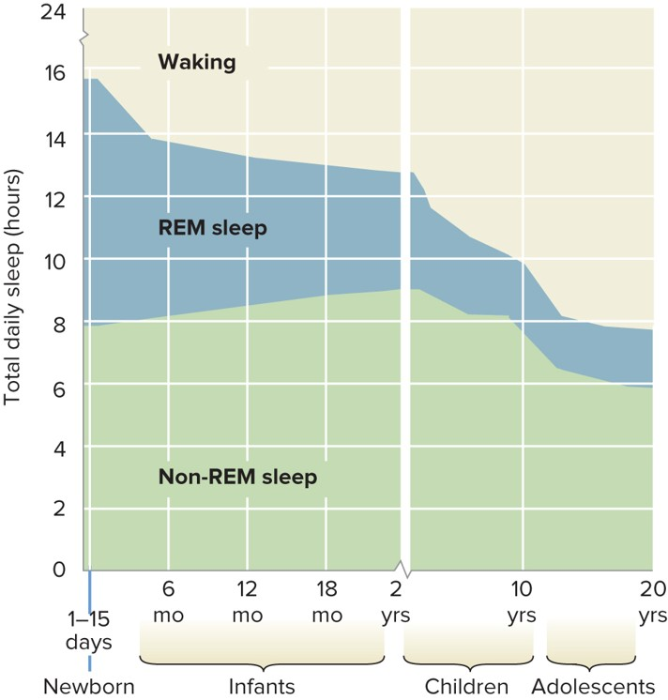
Changes in sleep over the lifespan
Dropoff in REM sleep in early childhood
  Newborns: ~50% of their sleep dreaming (REM Sleep)
  1-year-olds: ~25%
  Why so much REM sleep?

Slide 9
Changes in sleep over the lifespan
Need ~8 hours of sleep around adolescence
  By the start of adolescence:
    Sleep patterns approximate adults (less sleep vs. childhood)
    Environmental reasons for less sleep?

Slide 10
Sleep in Adolescence
Most teens do not get the optimal amount of sleep on school nights
Associated with decreased motivation
Report higher levels of depression, irritability, and lack of tolerance for frustration
Have difficulty controlling their emotional responses

Slide 11
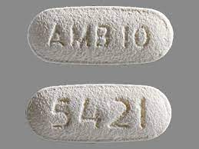
Sleep Disorders (1)
Insomnia == inability to sleep
  Problems falling asleep, waking up too early, waking up in the middle of the night, etc.
Sleeping pills can help, but…
  Stop working after a few weeks
  Long-term use can affect sleep quality

Slide 12
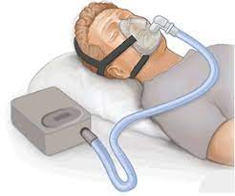
Sleep Disorders (2)
Narcolepsy == sudden, overpowering urge to sleep
  Straight to REM Sleep (skip over N1-N3)
Sleep Apnea == stop breathing during sleep
  Problem w/ windpipe or brain regions controlling respiration
  More common w/age
    Approx. 4% of US adults affected

Slide 13
Sleep Disorders (3)
Night terrors == sudden arousal from sleep w/ intense fear
  Physiological reactions like rapid heartbeat, loud screaming, etc.
  Generally no memory of a dream
  Occur during slow-wave sleep, most common in children 5-7 years old

Slide 14
Health and Wellness – Childhood (1 of 2)
Child Abuse
Maltreatment: intentional harm to a minor
  Physical or sexual
Neglect: depriving a child of adequate food, clothing, shelter, or medical care
Parents are most common perpetrators of physical abuse and neglect

Slide 15
Health and Wellness – Childhood (2 of 2)
Childhood Obesity:
  Body mass index—marker of body fat calculated from a person’s height and weight
  About 18% of school-age children are obese
  Short- and long-term health problems

Slide 16
Health and Wellness – Adolescence (1 of 3)
Only 25% of teenagers do the recommended 60 minutes of daily physical activity.
Obesity:
  Being 20% or more above the “ideal” weight for height, age, and sex
  Obesity rates have increased over the past 15 years.
Increase in rates of diabetes:
  High levels of sugar in the blood leading to various health problems

Slide 17
Health and Wellness – Adolescence (2 of 3)
Eating Disorders
  Anorexia Nervosa: excessive concern about body weight and attempts to lose weight, manifested through starvation, extreme exercise, low weight, and a distorted body image
  Bulimia Nervosa: excessive concern about body weight and attempts to lose weight, manifested through recurrent episodes of binge-eating followed by purging
  Binge Eating Disorder: eating large amount of food much in a discrete period associated with feeling out of control

Slide 18
Health and Wellness – Adolescence (3 of 3)
Depression
  Feelings of sadness, hopelessness, frustration; changes in sleep and eating habits; problems with concentration; loss of interest in activities; loss of energy and motivation
Risk Factors: Genetics and Environment
  Increase in adolescents with depressive symptoms during the early period of the pandemic
  Perceived parental support

Slide 19
Depression Risk Factors
Some risk factors for adolescent depression:
  Poor emotion regulation
  Extremely negative self-beliefs
  Emotionally distant, uninvolved parents
  Punitive discipline
  Poverty
  Disturbed levels of serotonin and/or norepinephrine

Slide 20
Health and Wellness – Adulthood (1 of 6)
Chronic diseases:
  Conditions that persist over at least a year
  Require ongoing medical care
    manage not cure!

Slide 21
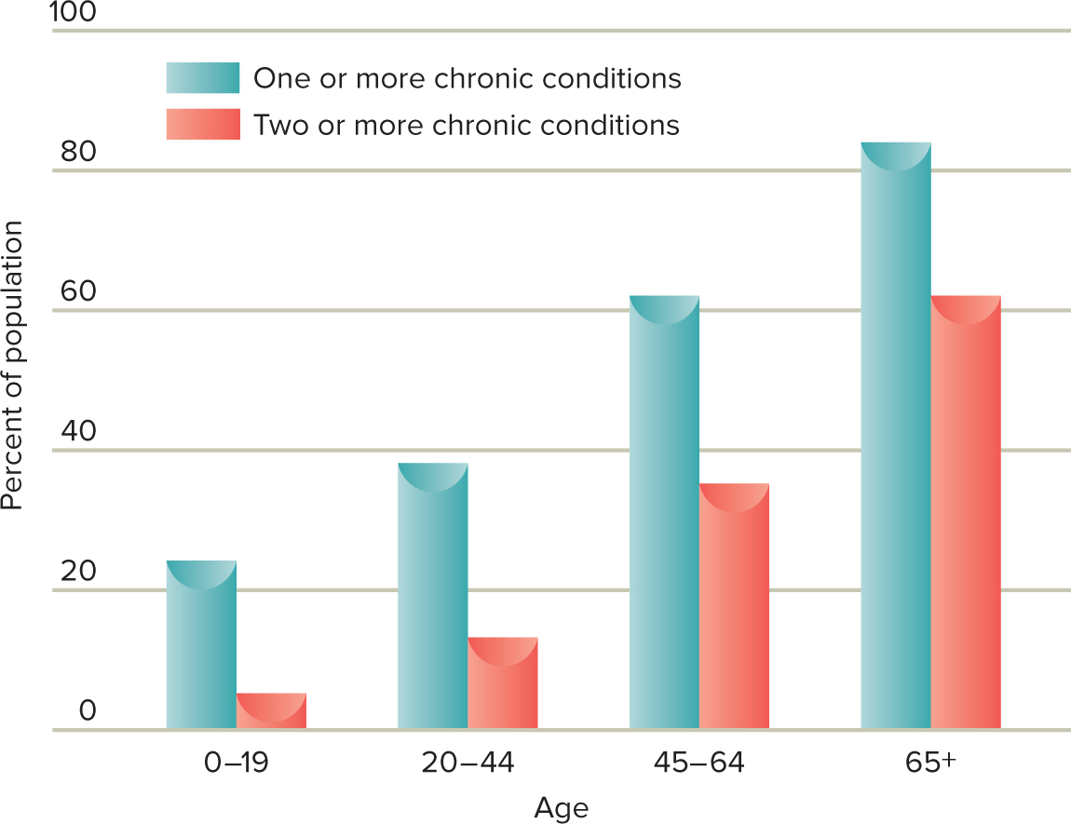
Prevalence of Chronic Conditions Across Age Groups

Slide 22
Health and Wellness – Adulthood (1 of 5)
Cardiovascular Disease
  Responsible for over 25% of deaths of middle-aged Americans each year; markers include hypertension, high blood cholesterol, and atherosclerosis
  Risk Factors: heredity, age, diet heavy in saturated and trans-fatty acid, smoking, hypertension
  Treatment depends on severity; medication, changes to physical activity and diet, angioplasty, or coronary bypass surgery

Slide 23
Health and Wellness – Adulthood (2 of 6)
Diabetes
  High levels of blood glucose
  Type 1 vs. Type 2
    Type 1: Develops early in life; autoimmune reaction
    Type 2: Develops later in life; related to lifestyle habits and obesity

Slide 24
Health and Wellness – Adulthood (3 of 6)
Diabetes
  18% of adults age 45-65 have diabetes; 27% of adults 65+
  Higher risk of heart attack, stroke, circulation problems in the legs, blindness, and reduced kidney functions
  Treatment includes diet and exercise, blood testing, taking insulin

Slide 25
Health and Wellness – Adulthood (4 of 6)
Arthritis
  Degenerative joint disease
  Osteoarthritis: affects joints that are injured by overuse
  Rheumatoid arthritis: autoimmune illness in which the connective tissues become inflamed and stiff, thicken, and release enzymes that digest bone and cartilage
  Managed, not cured

Slide 26
Health and Wellness – Adulthood (5 of 6)
Obesity in Adulthood
  Sedentary lifestyle, little physical activity, and screen time closely associated with obesity
  Contextual factors may encourage/deter health-related activities
  Treatment: lifestyle changes and training in problem-solving skills helps manage stress

Slide 27
Health and Wellness – Adulthood (6 of 6)
Cancer
  Leading cause of death in adulthood
  Cells undergo uncontrolled growth:
    Mutations may cause cancer genes to undergo abnormal cell division
    Mutations interfere with tumor suppressor genes
    Mutations may prevent cells from repairing DNA errors
  People of low SES experience cancer at higher rates
  Survival rates vary by type of cancer

Slide 28
Health and Wellness – Older Adults
70-and-older age group:
  Have at least one chronic impairment
    Sensory loss
    Arthritis 43% of elderly men; 54% of elderly women
    Hypertension
    Degenerative disease
Exercise :
  Aging adults feel less stressed and happier
  Can enhance their cognitive functioning
  Can delay the onset of physical disabilities by up to 7 years
Cannot halt the inevitable aging process.

Slide 29
Aging and Health (1 of 2)
Physical Activity and Exercise
Physical activity tends to decline in adulthood
But… physical fitness is linked to cognitive performance in adulthood

Slide 30
Aging and Health (2 of 2)
Snowdon’s Nun Study (2003)
  678 nuns ranging in age from 75 to 106 years
  Level of education affected longevity and health.
    Those with college degree lived longer.
  Nuns who were active, both physically and mentally, lived longer and healthier.

Slide 31
Stress and Health (1 of 3)
What are the stressors in your life?
  Catastrophes
  Major life events
  Daily hassles

Slide 32
Types of Stress (1)
Acute Stress
  Sudden, one-time life events (trauma, sudden death, etc.)
  Associated with poor immune system function
Notes:
Suggestion: Tie this back to Selye’s G.A.S. model.

Slide 33
Types of Stress (2)
Chronic Stress
  Long-term worry/stress (relationship problems, financial worries, etc.)
  Also related to immune system problems, but problems are more long-term than acute stress
Notes:
Suggestion: Tie this back to Selye’s G.A.S. model.

Slide 34
Stress and Health (2 of 3)
Most common source of stress arises from the hassles that irritate us every day.
“Microstressors” place a constant strain on us.
  The accumulation of daily hassles contributes more to illness than do major life events.
  Job burnout, commuting, financial pressure, etc.
Socioeconomic status (SES) is a powerful proxy for the hassles of everyday living.

Slide 35
Impact of Stress
Cardiovasular Disease
  chronic emotional stress
  major life changes increase risk
Cancer
  stress inhibits cellular immune responses

Slide 36
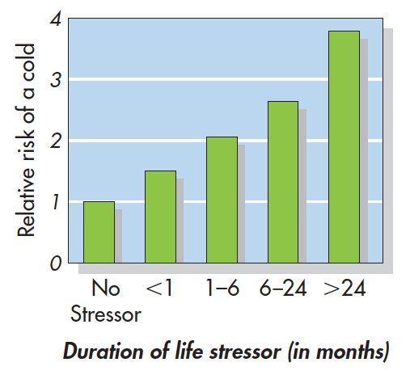
Stress and Health (3 of 3)
Cohen et al. (1998)
  Chronic stress is associated with risk for both acute and chronic illnesses

